Slide 1
Design of MIMO Antenna for Radar Applications
Mentor - Dr. Divyabramham K
BTP Code - B22DB03
Members:
Kakarla Pavan Teja (S20190020216)
Divishad Reddy (S20190020236)

Slide 2

Title - Design of MIMO Antenna
Problem statement
Simulators
Introduction
Design methodology
Results
Challengers
References

Slide 3
Problem statement (Recap)
Design of MIMO antenna setup for radar application
All elements (transmitters) of the transmitting array simultaneously radiate mutually orthogonal signals shift in frequency (OFDM)
These transmitting signals don’t interface because of orthogonality
At a target, sum of all radiated signals with their specific phase shifts depending on the target position and velocity
Each element of the receiving array receives reflected signals of all frequencies. This signals can be separated and then processed properly

Slide 4
Simulators Used
Single, 2*1 patch antennas are built using CST simulator
Antenna Designer tool in Matlab helps us in designing antennas with inbuilt models, materials, etc.. and it can also be converted to matlab files(,m, .mat)
In Matlab, calculated dimensions of single, 2*1 antenna and design of single microstrip patch antenna
Feed method (Inset feeding method) is used for the input to antenna
Visualization of plots (like S-parameter, VSWR, Gain, Radiation pattern, etc…
Patch antenna are for low profile application of frequency above 100 MHz

Slide 5
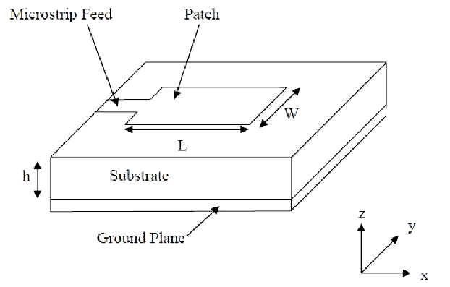
Microstrip Patch Antenna
One side of substrate has ground plane and other microstrip patch
L - length of micro-strip
W-width of micro-strip
h - Height of dielectric substrate
Lightweight and easy to integrate with circuits
Microstrip feed can modeled using different feeding techniques

Slide 6
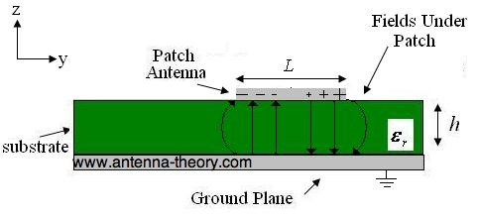
Microstrip Patch Antenna - Fringing Fields
The fringing fields around the antenna can help explain why the microstrip antenna radiates
Current at feeding point and side end of patch is zero(open circuit end) and maximum at middle
low current value at the ends, impedance at ends is high
Due to open circuited transmission line, voltage and current are out of phase and fields under patch resemble as shown in figure
This fields are called fringing fields
Notes:
The current adds up in phase on the patch antenna as well; however, an equal current but with opposite direction is on the ground plane, which cancels the radiation. This also explains why the microstrip antenna radiates but the microstrip transmission line does not

Slide 7
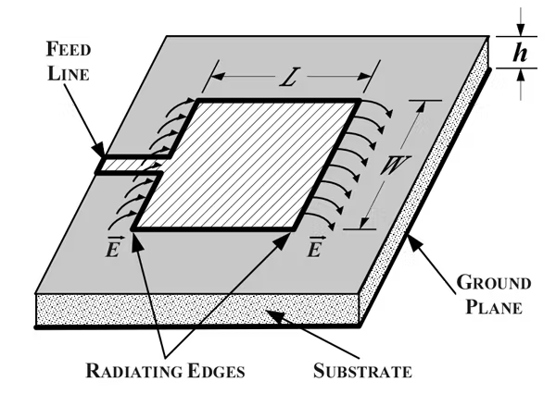
Microstrip Patch Antenna - Radiation
Fringing fields have a great effect on the performance of antenna
Radiation doesn't happen along the length(L) of microstrip
Electric field at the center of the patch is zero
The radiation is due to the fringing field between the periphery of the patch and the ground plane

Slide 8
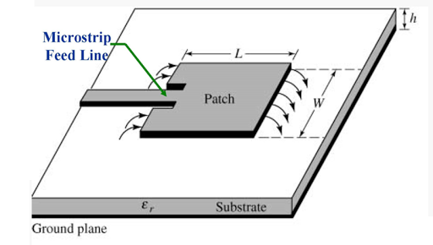
Inset feeding method
It is a conducting strip with width extremely smaller
The feed line to patch can be given center, edge
Impedance of the antenna can be controlled by this feeding method due to planar structure
An inset feed microstrip patch antenna is designed to increase the radiation
Due to thinner dimensions of the strip, it's easy to fabricate and integrate in Printed circuit boards (PCBs)

Slide 9
What effects the patch antenna
Width controls -
Larger width, increase radiation from patch antenna
Wider patch, lower input impedance
Length of patch antenna controls resonant frequency of antenna.
Permittivity of dielectric material controls
Higher the permittivity -increases input impedance.
Lower the permittivity -increases the antenna bandwidth, efficiency, better radiation

Slide 10
Design methodology
Designing of Single microstrip patch antenna using inset feeding method
First, we need to calculate the dimensions of microstrip patch, substrate by using matlab
In CST, build the single microstrip patch antenna using shapes(rectangle) and assign port to the antenna
Next, we need to build 2-1 microstrip antenna using existing single microstrip patch antenna

Slide 11
Design methodology
In Matlab, Antenna designer tool helps us in using the predefined antenna models
We need provide the dimensions, properties of substrate and patch
After simulation, we can compare the values with CST values
Results of CST and Matlab are different due to their simulation properties

Slide 12
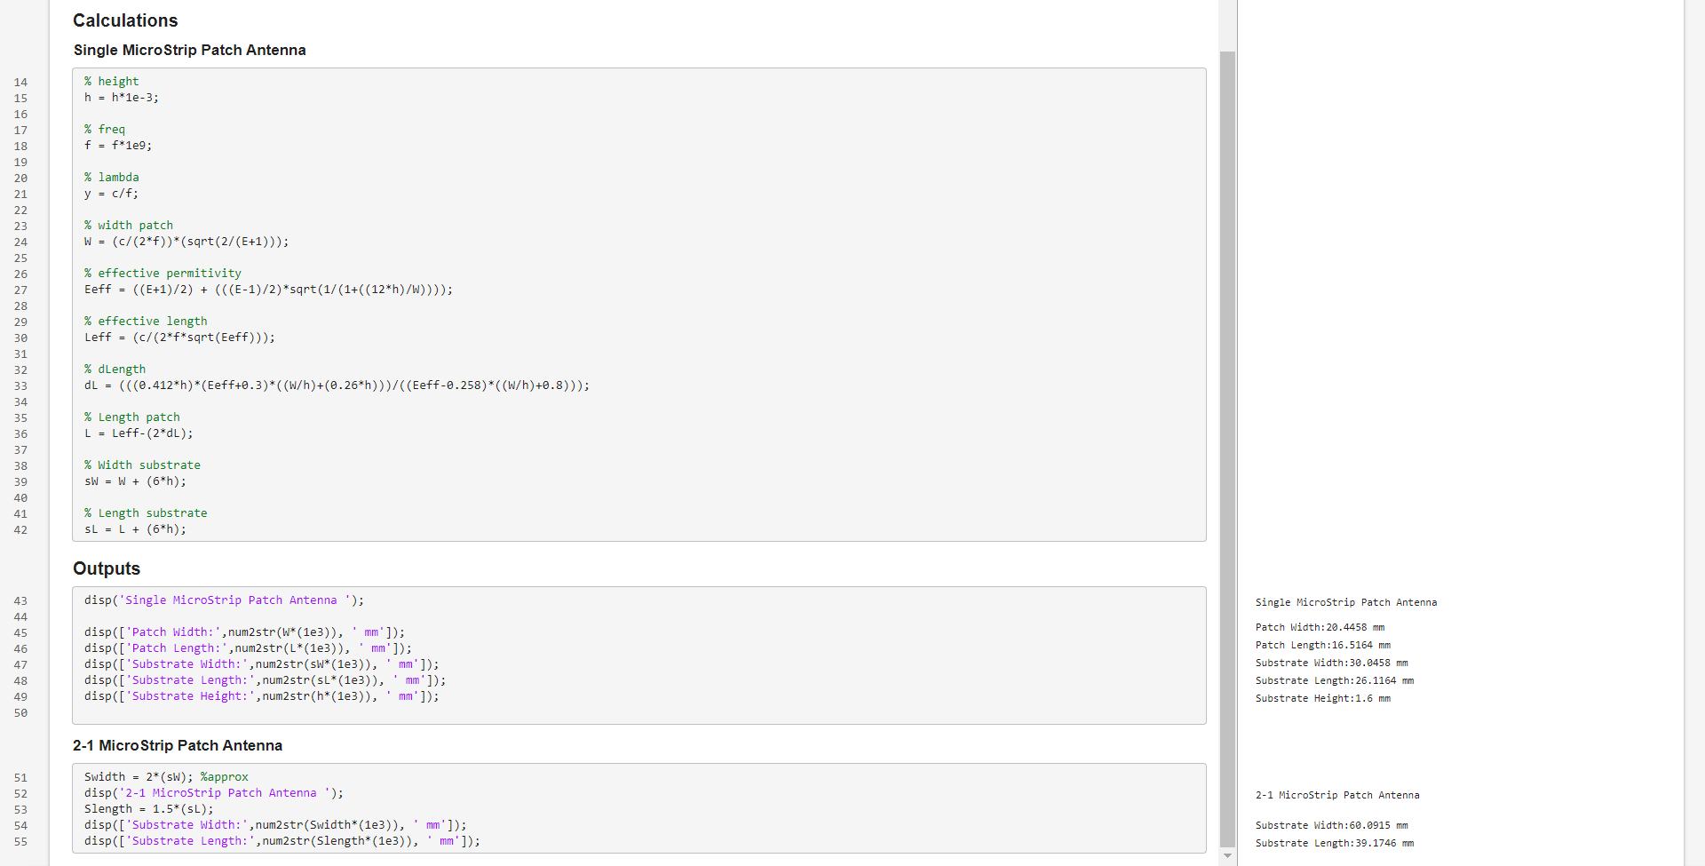
Matlab Calculations for Antenna Dimensions

Slide 13
Parameters
Parameters / Antenna | Single MicroStrip Patch | 2-1 MicroStrip Patch
Epsilon_r (er) | 2.2 | 2.2
Substrate Width (Ws) | 30.04 | 59.44
Substrate Length (Ls) | 26.08 | 38.77
Substrate Height (h) | 1.6 | 1.6
Patch Width (Wp) | 20.44 | 20.44
Patch Length (Lp) | 16.48 | 16.065
Feed Width (Wf) | 4.971 | 4.971
Inset Feed Length(y0) | 6 | 6
Inset Width (x1) | 0.5 | 0.5
Connecting Line Length | — | 3.23 (assumed)

Slide 14
Results
CST
Matlab

Slide 15
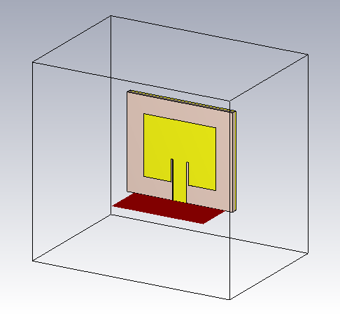
Results(CST) - Single Patch Antenna
Single Microstrip Patch Antenna

Slide 16
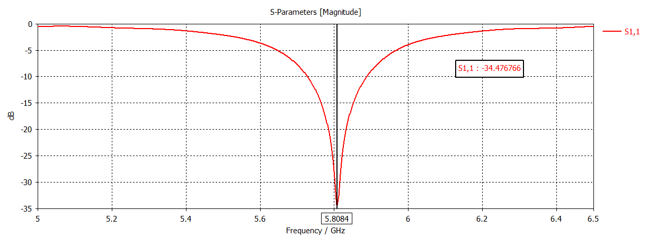
Results(CST) - Single Patch Antenna

Slide 17
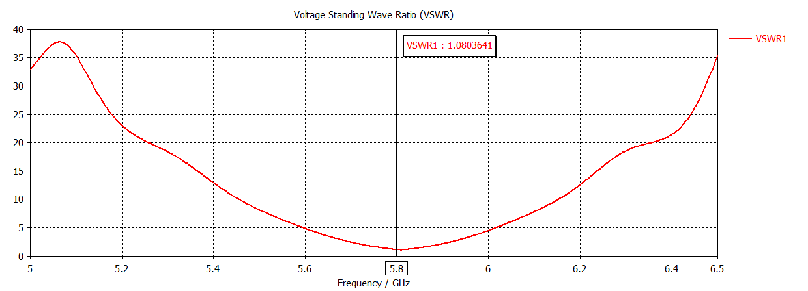
Results(CST) - Single Patch Antenna

Slide 18
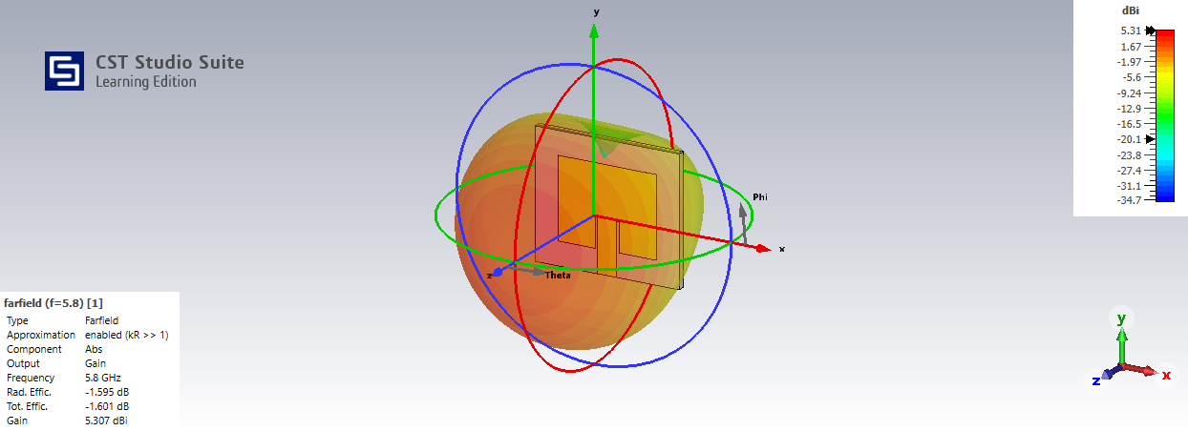
Results(CST) - Single Patch Antenna

Slide 19
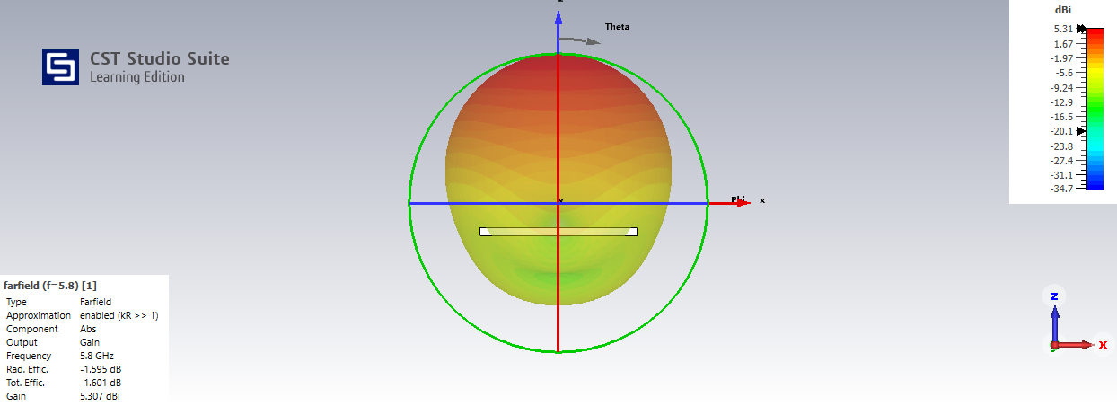
Results(CST) - Single Patch Antenna

Slide 20
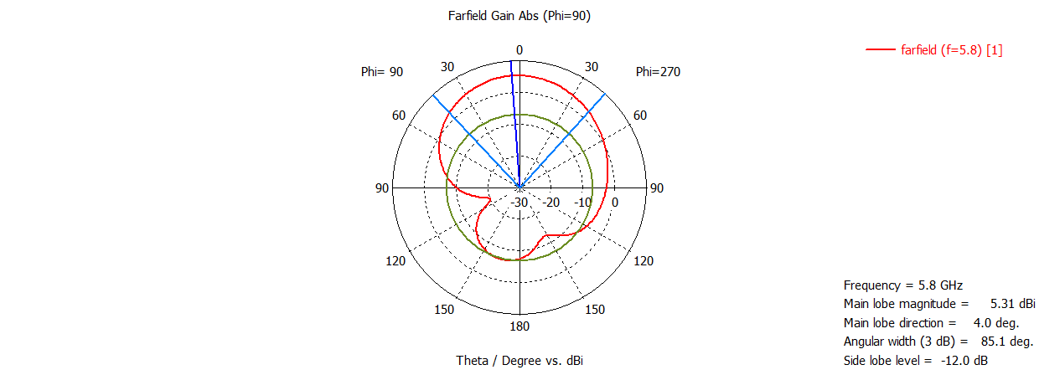
Results(CST) - Single Patch Antenna

Slide 21
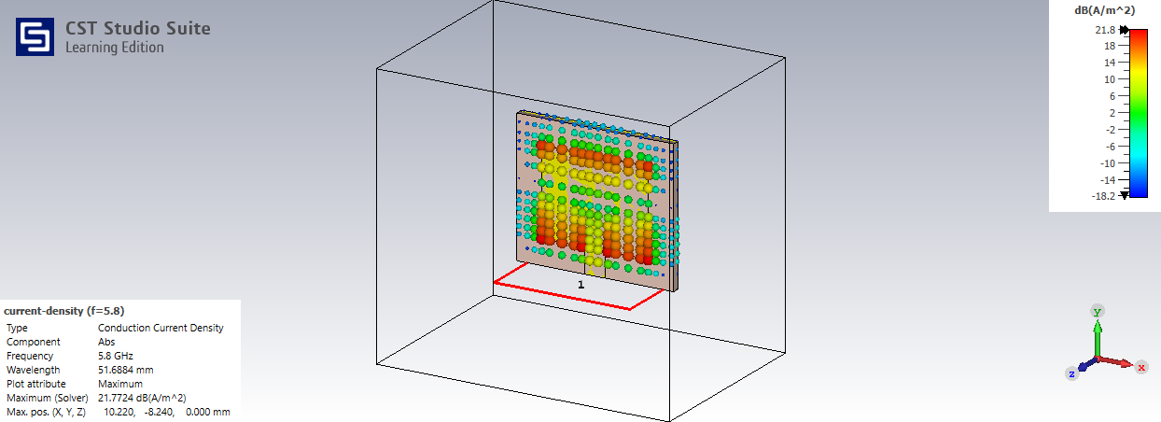
Results(CST) - Single Patch Antenna

Slide 22

Results(CST) - Single Patch Antenna
Current Flow

Slide 23
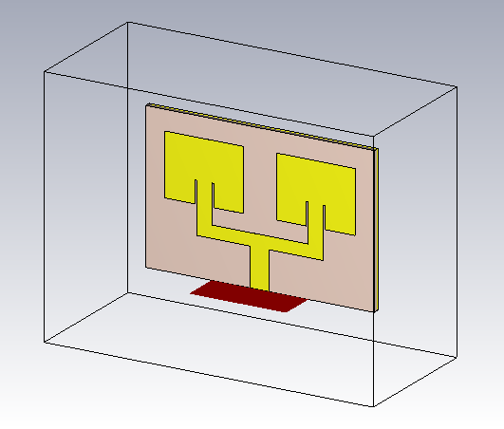
Results(CST) - 2-1 Patch Antenna
2-1 Microstrip Patch Antenna

Slide 24
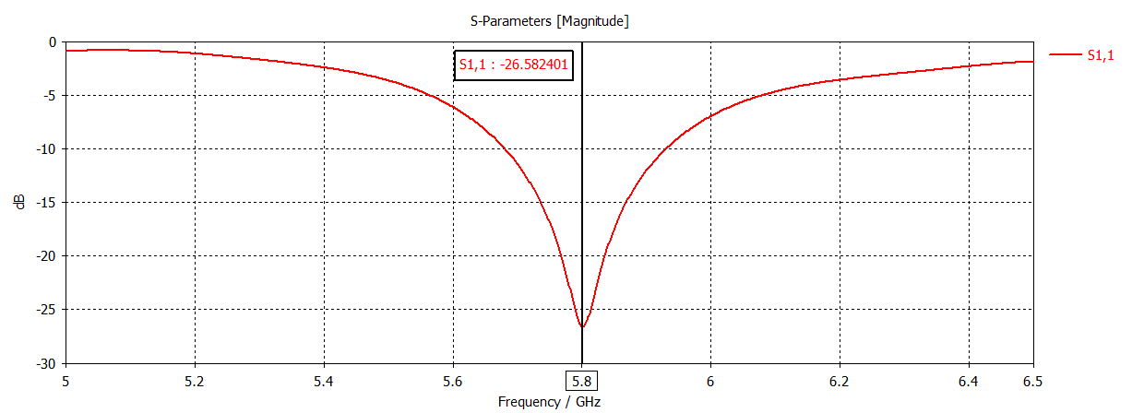
Results(CST) - 2-1 Patch Antenna

Slide 25
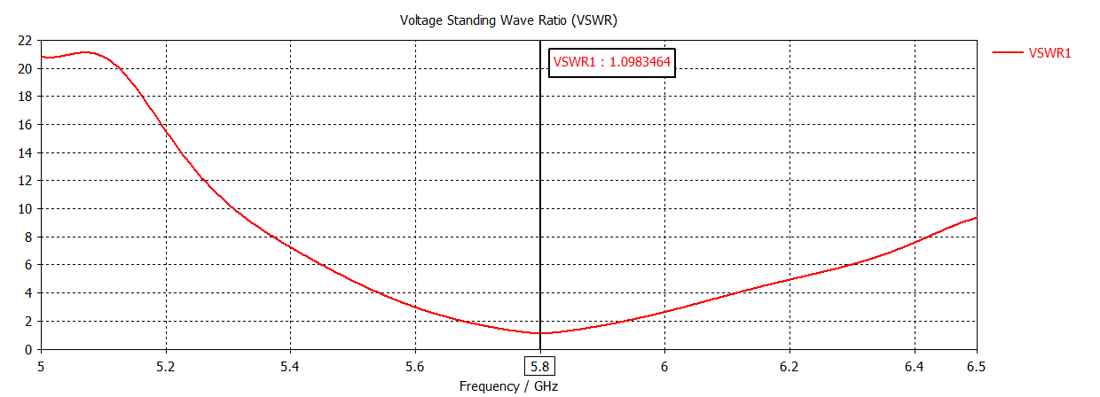
Results(CST) - 2-1 Patch Antenna

Slide 26
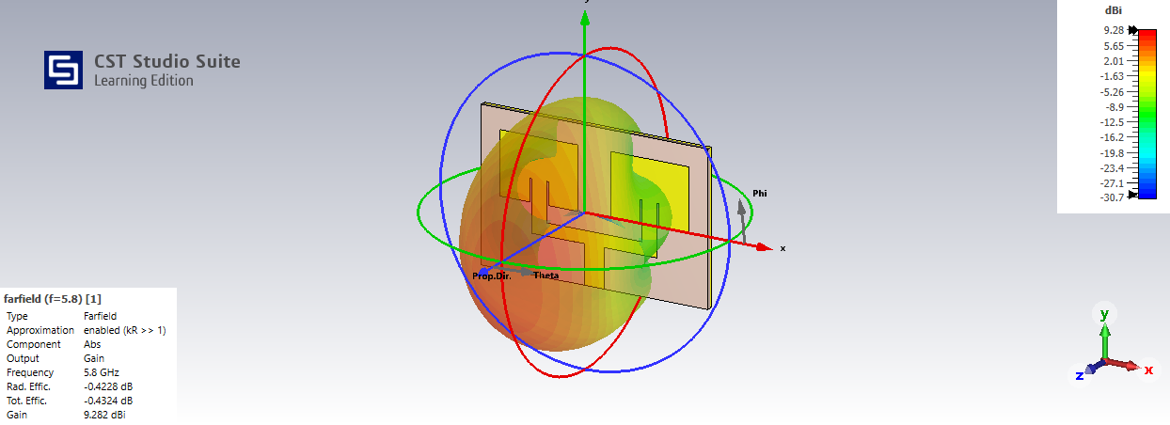
Results(CST) - 2-1 Patch Antenna

Slide 27
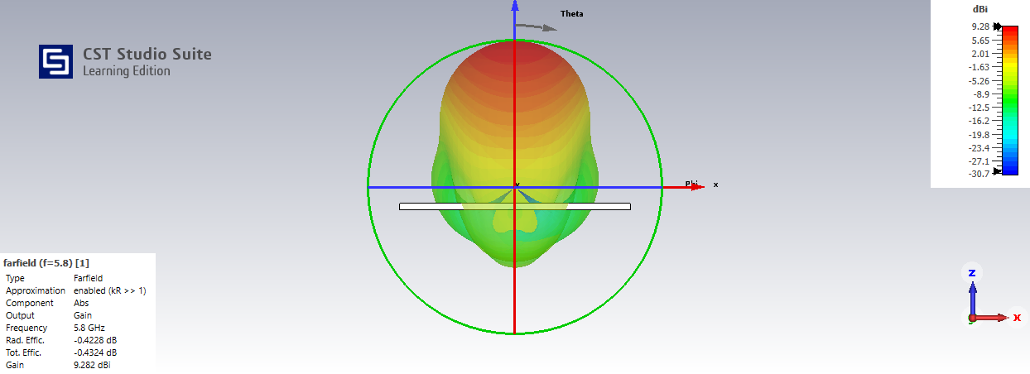
Results(CST) - 2-1 Patch Antenna

Slide 28
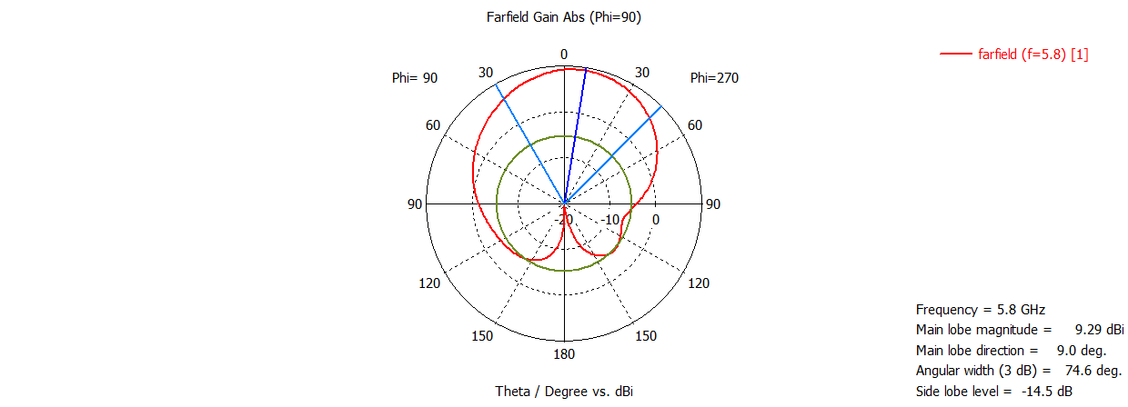
Results(CST) - 2-1 Patch Antenna

Slide 29
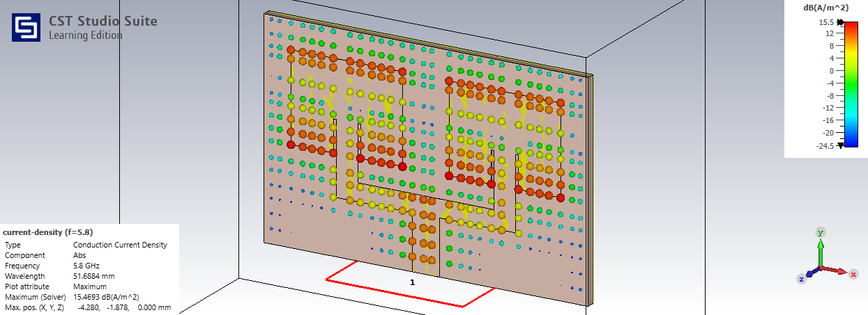
Results(CST) - 2-1 Patch Antenna

Slide 30
Results(CST) - 2-1 Patch Antenna
Current Flow

Slide 31
Comparing Results
Characteristics / Antenna | Single Microstrip Patch | 2-1 Microstrip Patch
S-Parameter | -34.47 | -26.58
Gain (dBi) | 5.31 | 9.29
Max Current density(J) (A/m^2) | 21.77 | 15.46
VSWR | 1.08 | 1.098

Slide 32
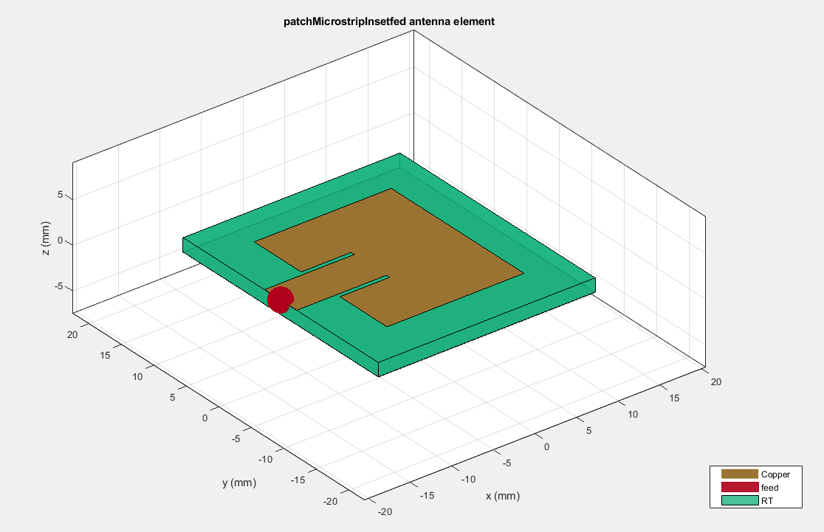
Results(Matlab) - Single Patch Antenna

Slide 33
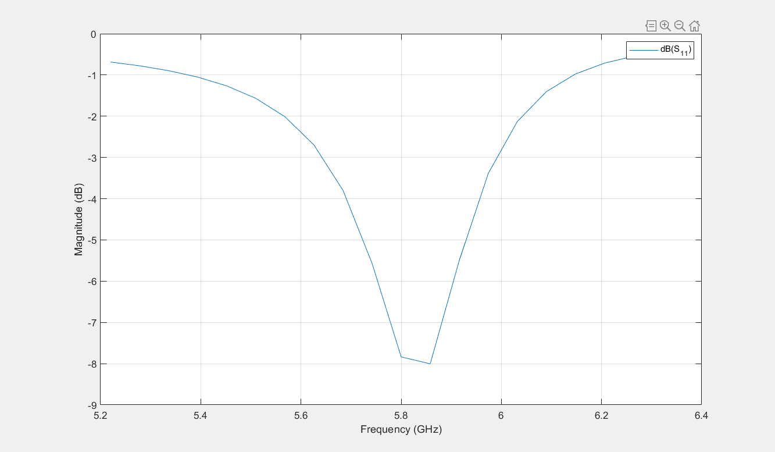
Results(Matlab) - Single Patch Antenna

Slide 34
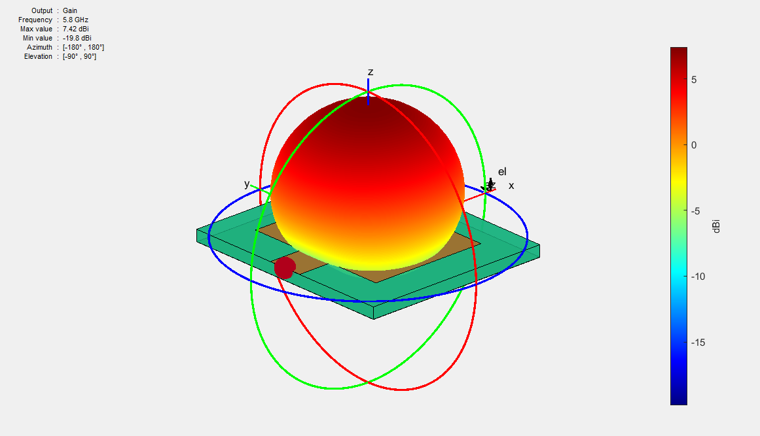
Results(Matlab) - Single Patch Antenna

Slide 35
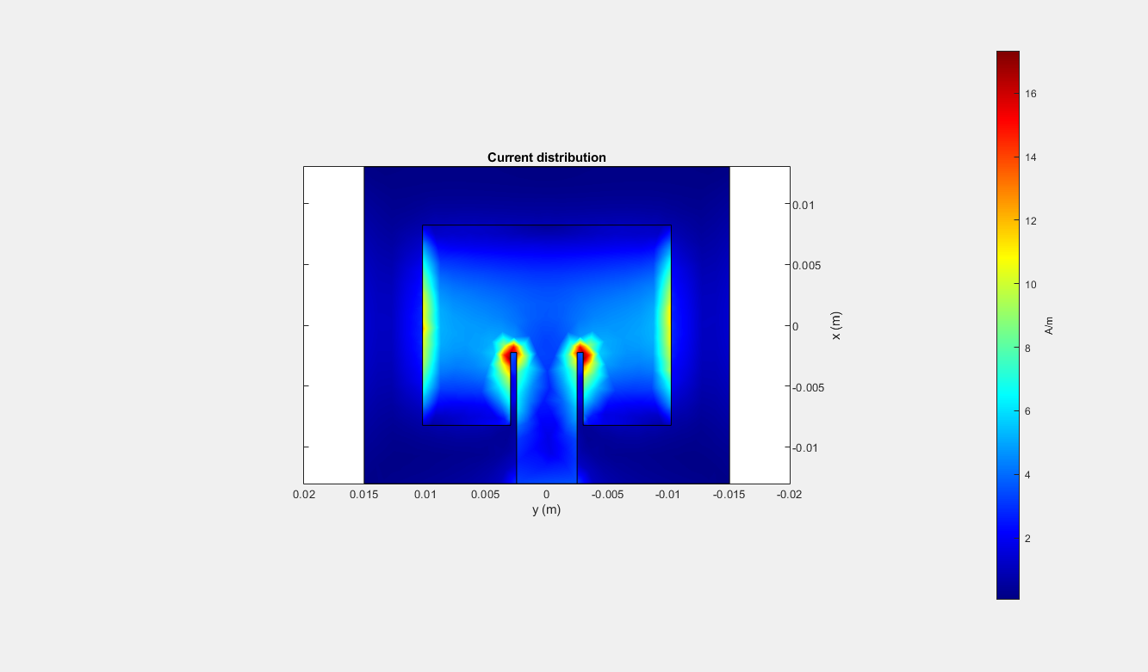
Results(Matlab) - Single Patch Antenna

Slide 36
Timeline
Introduction about antenna radars
Problem statement
Modeling of MIMO antenna
Simulation for antenna parameters
Phase - 1
Phase - 3
Phase - 2
Phase - 4
Modeling of Single antenna
Challengers
Designing of MIMO antenna

Slide 37
Challenges
Simulators were found to be difficult to understand
In Matlab, we found difficult to simulate array antennas because inset feed patch method is not pre defined in array antenna designer
The design of MIMO antenna from single antenna requires:
Calculating the area covered by each antenna on dielectric material(substrate material)
Inputs to the patch antenna changes depending on the applications
Depending upon the no. of inputs (no. of transmitters) radiation of antenna changes

Slide 38
References
O. OUAZZANI, S. D. BENNANI, M. JORIO, “Design and Simulation of two elements rectangular Microstrip Patch Antenna at 5.8 GHz for RFID Reader Applications with high Directivity and Gain”, in 2018 6th International Conference on Multimedia Computing and Systems (ICMCS). ReferenceLink
Sankar Sadasivam, Shaury Anand, “Multi Channel RF Transceiver Reference Design for Radar and Electronic Warfare Applications”, in Texas Instruments Incorporated, 2019. Reference Link
Antenna basics and designing

Slide 39
Thank you!

